Slide 1
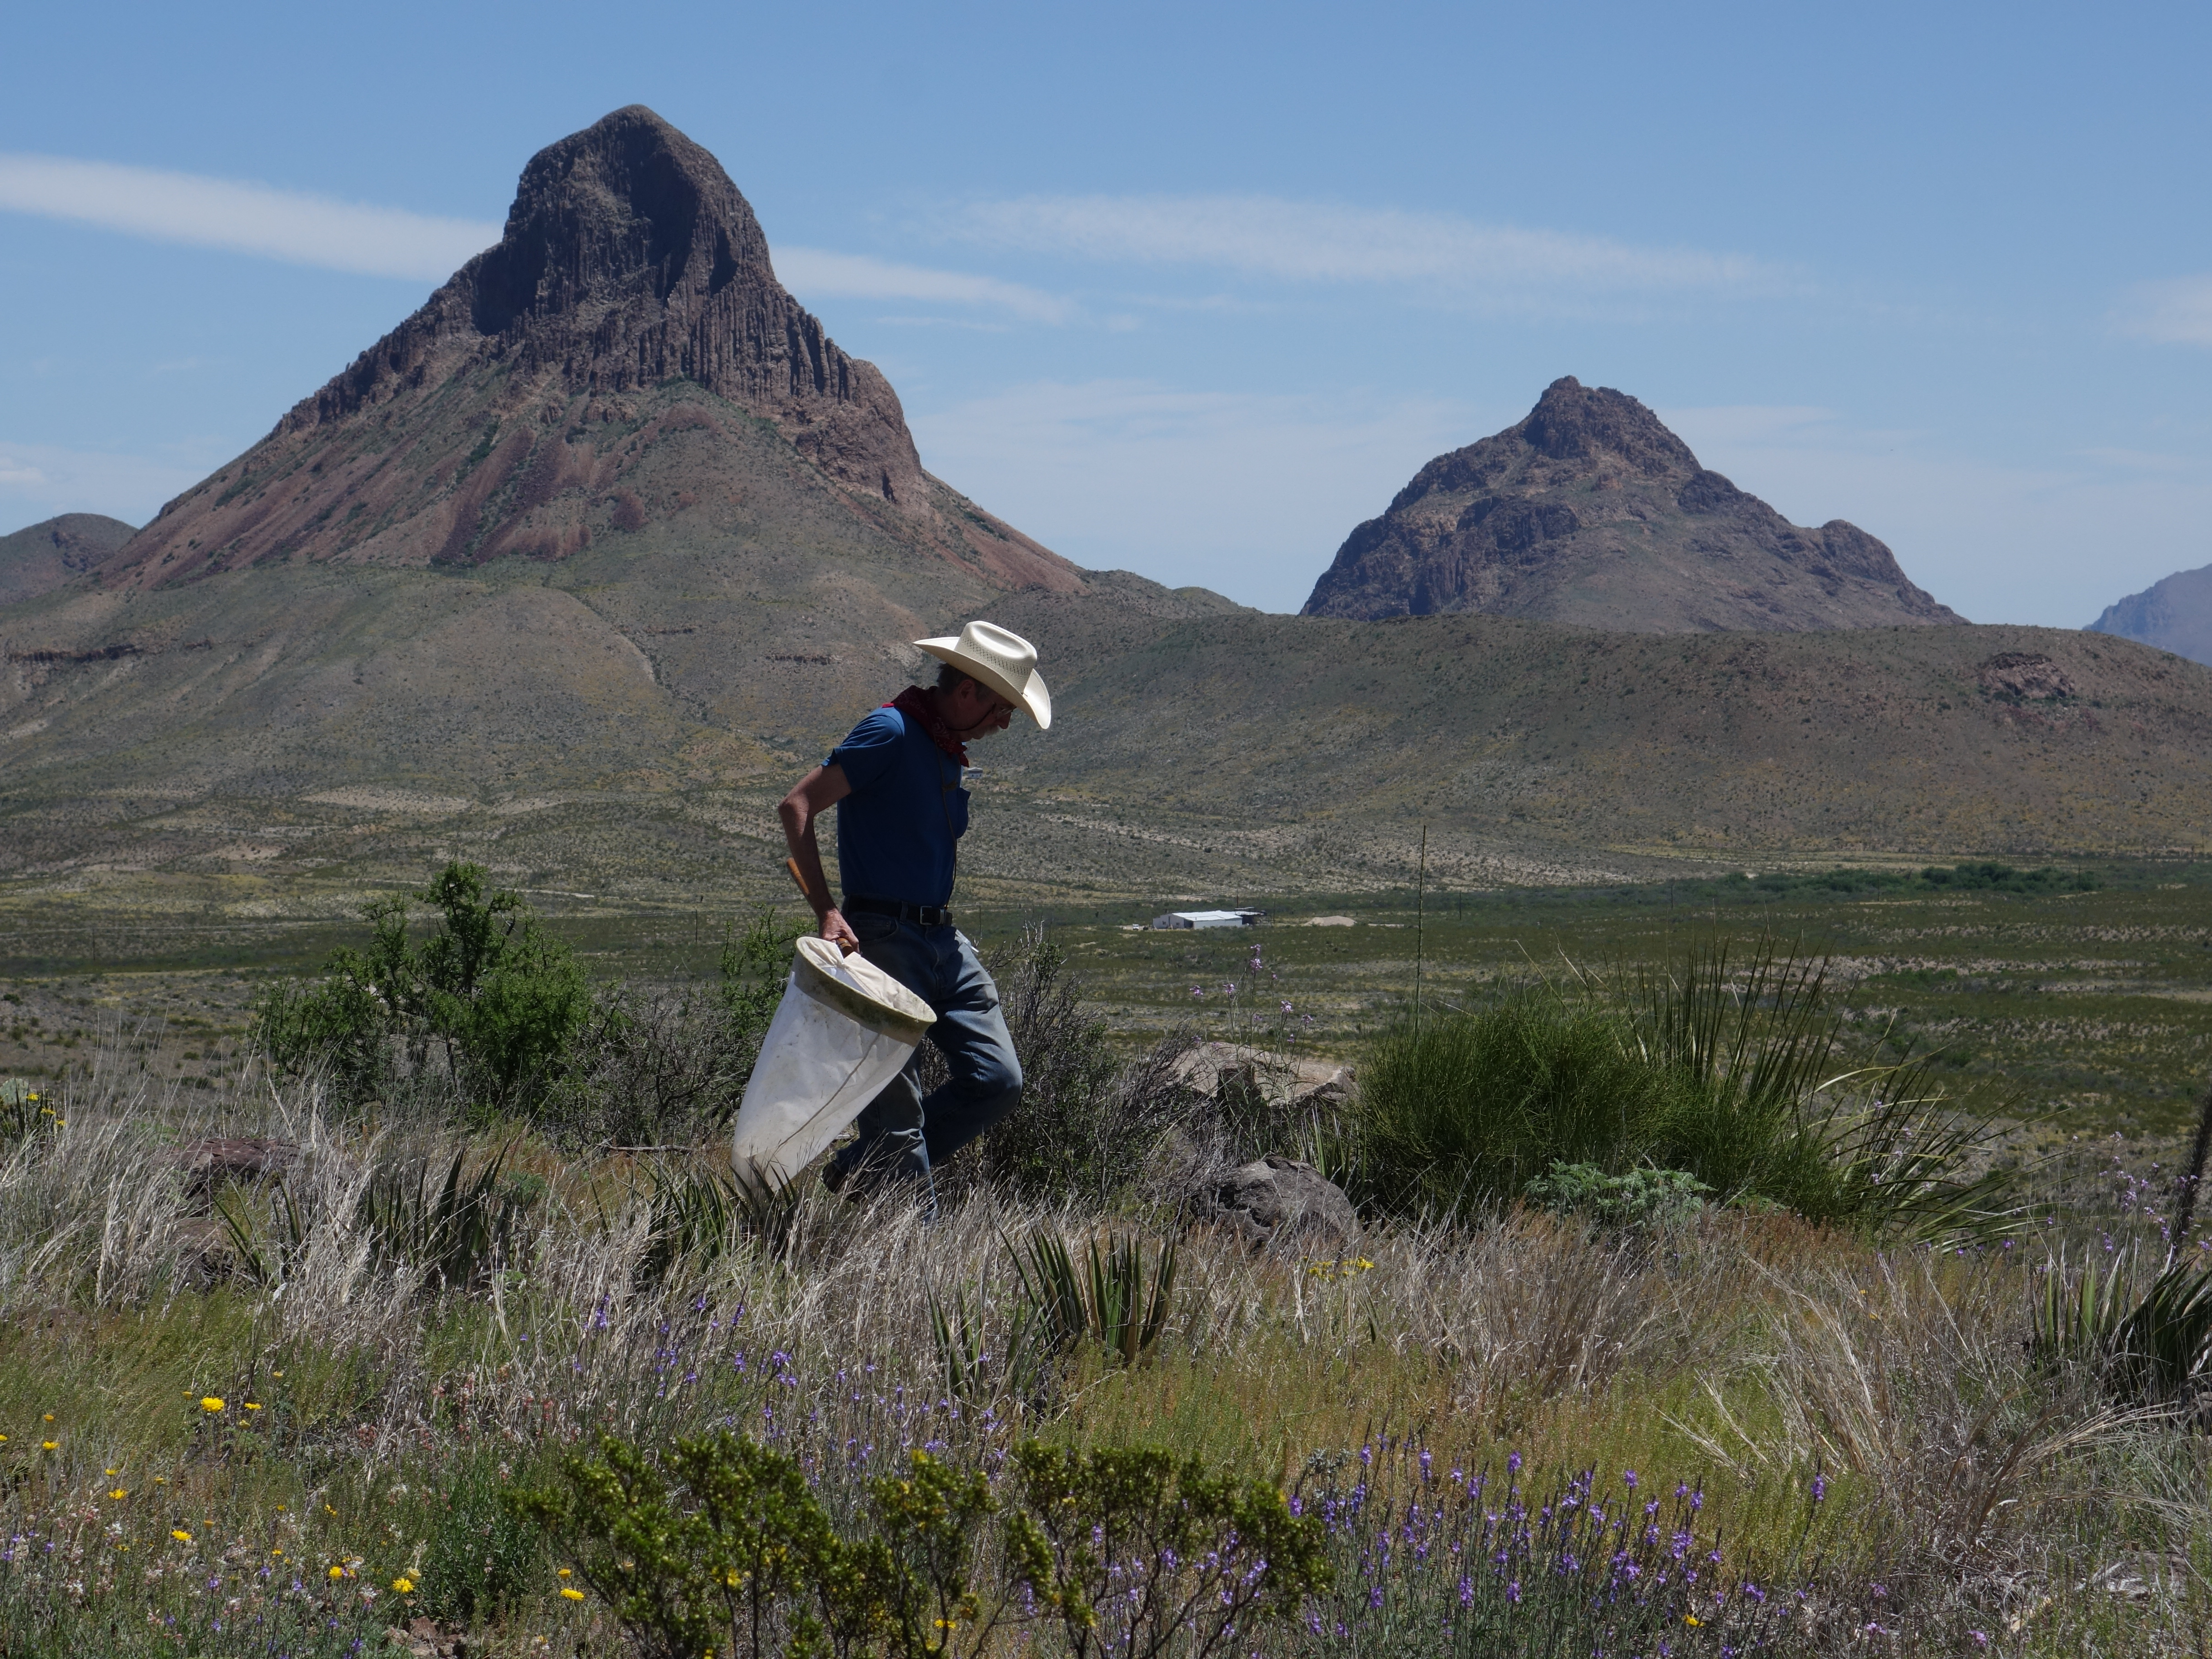
Texas Entomology

